Slide 1
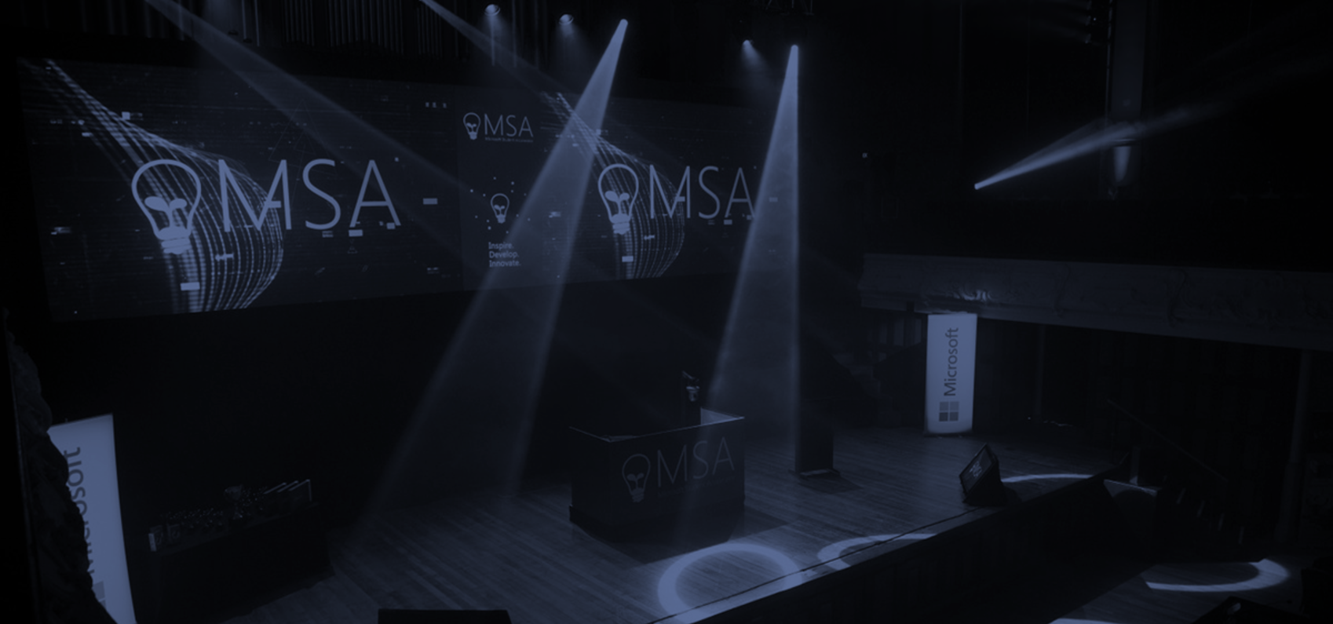

Microsoft Student Accelerator
Inspire. Develop. Innovate.

Slide 2





Imagine Cup Junior
ATTEND or LEARN
DEVELOP
ACTIVATE
PUBLISH
ENTER
Notes:
[click]
Watch videos on this website, specially created by Microsoft Student Partners.
[click]
Create a game using Construct 2 based on the learnings from the Videos you saw on Channel9.
[click]
Activate Microsoft Azure as perVideo 10.
[click]
Get a special code to activate Microsoft Azure and publish your game as a website. Watch Video 11.
[click]
Submit your entry for the competition by filling in this form.

Slide 3







Publish Anywhere…
Notes:
Construct 2 publishing
HTML5 website -> web server
Scirra Arcade
WP8 or Windows 8
PhoneGap -> iOS or Android

Slide 4
Requirements
Groups of 2 to 4 students (Only for JHack)
Construct 2 Game Published on Azure as a Web App, with:
Start Screen
Game Screen
End Screen
Add one of the below:
Parallax
Scoring
Source Control via GitHub
Facebook Integration

Slide 5
Judging Criteria - JHack
100%
Concept (25%)
Fun (40%)
Execution (20%)
Requirements (15%)
Only Construct 2 Games are allowed

Slide 6
Submission
Submit through http://msa.ms/jhacksubmit

Slide 7
Next Steps
Visit http://jhack.co.nz
Resources available at http://msa.ms/jhack
Join the Facebook group at http://msa.ms/fbgroup
Keep looking at your emails! ☺

Slide 8
Thank you!

